Slide 1

Statistical Parametric Mapping for fMRI / MRI / VBM
Guillaume Flandin
Wellcome Centre for Human Neuroimaging
University College London
SPM Short Course

Slide 2
Statistical Parametric Mapping
Concepts
Software
Resources

Slide 3
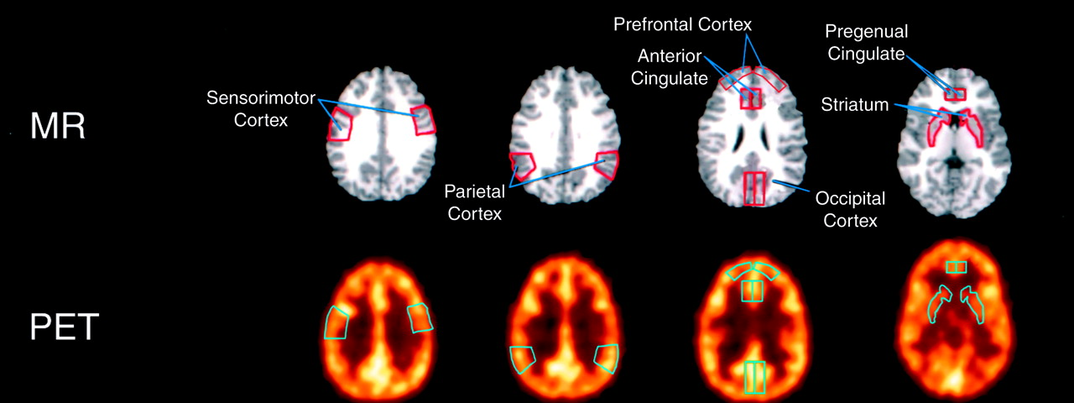
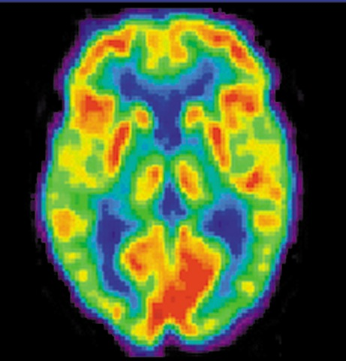
From PET analyses using ROIs…

Slide 4
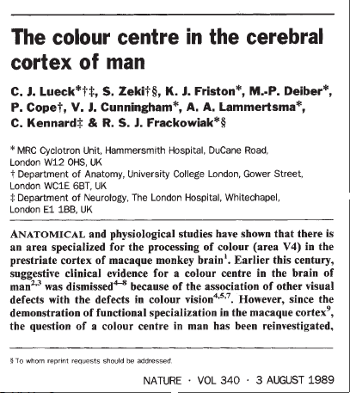
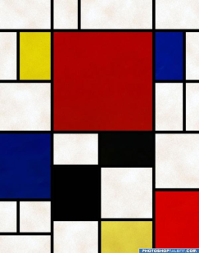
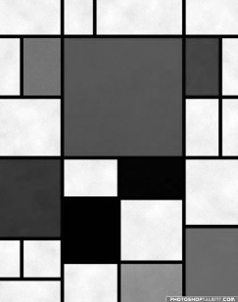
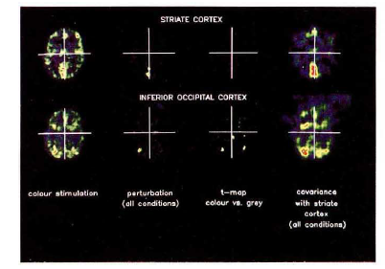
…to the very first SPM{t}
An area specialised for the processing of colour, the“colour centre” (V4) highlighted by cognitive substraction using PET.
Three subjects:
Compatible with earlier findings on monkeys using electrophysiology.
Colour trials (2 scans)
Grey trials (2 scans)
Notes:
4

Slide 5
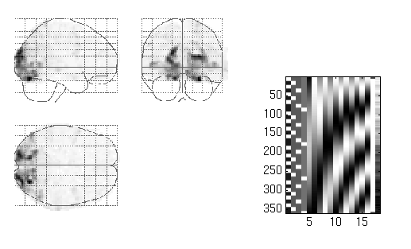
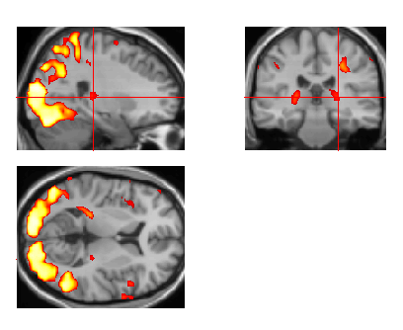
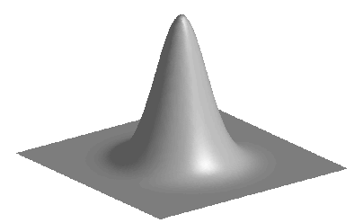
Image time-series
Spatial filter
Design matrix
Statistical Parametric Map
Realignment
Smoothing
General Linear Model
Statistical Inference
RFT
Normalisation
Anatomical reference
p <0.05
Parameter estimates

Slide 6
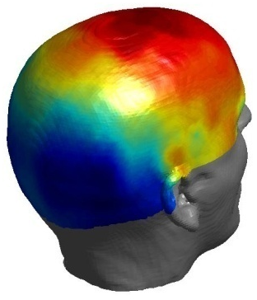
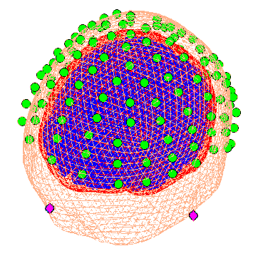
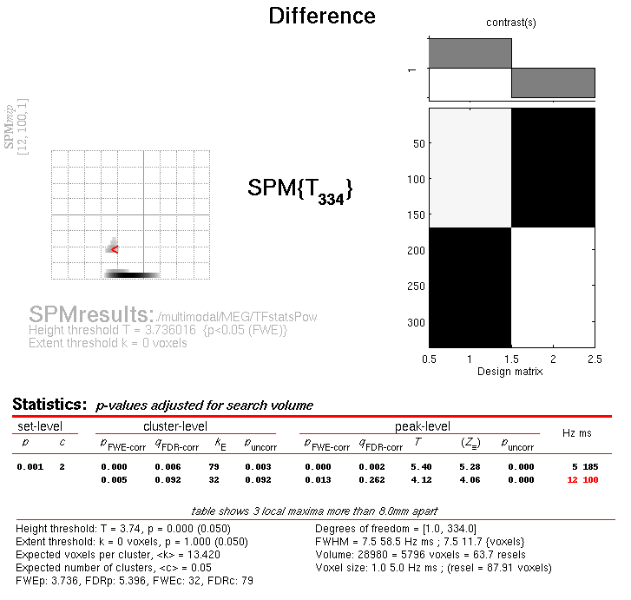
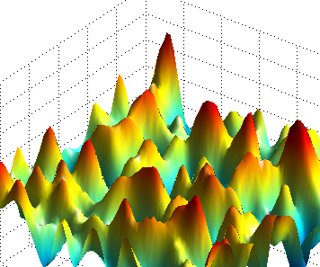
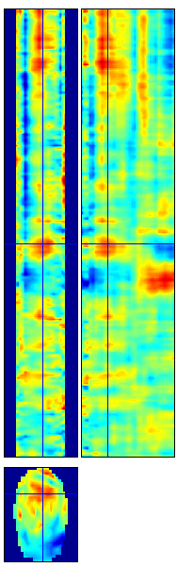
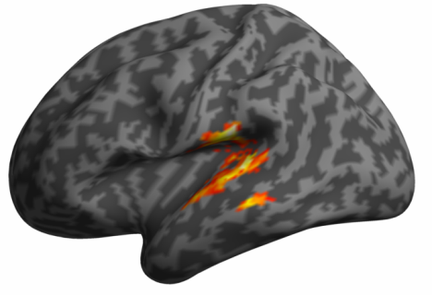
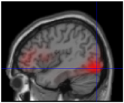
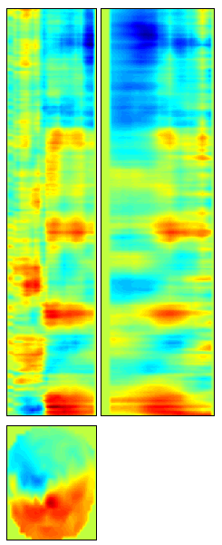
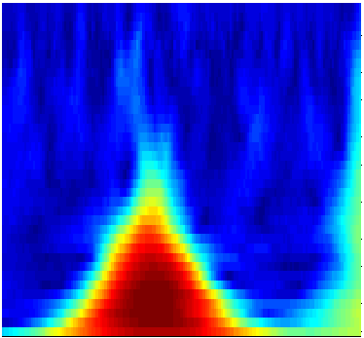
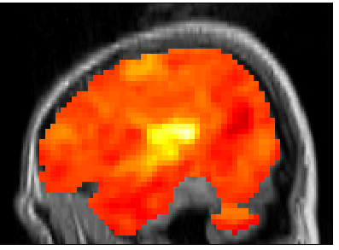
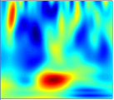
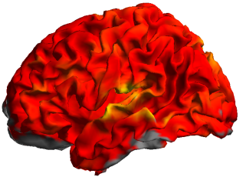

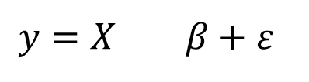

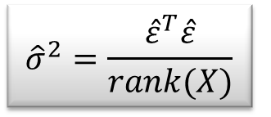
M/EEG Data Analysis
Random
Field Theory
$$y=X β+ε$$
Contrast c
Pre- processings
General Linear Model
Statistical Inference
$$\hat{β}={\left(X^{T}X\right)}^{−1}X^{T}y$$
$${\hat{σ}}^{2}=\frac{{\hat{ε}}^{T}\hat{ε}}{rank(X)}$$
$$SPM\{T,F\}$$

Slide 7
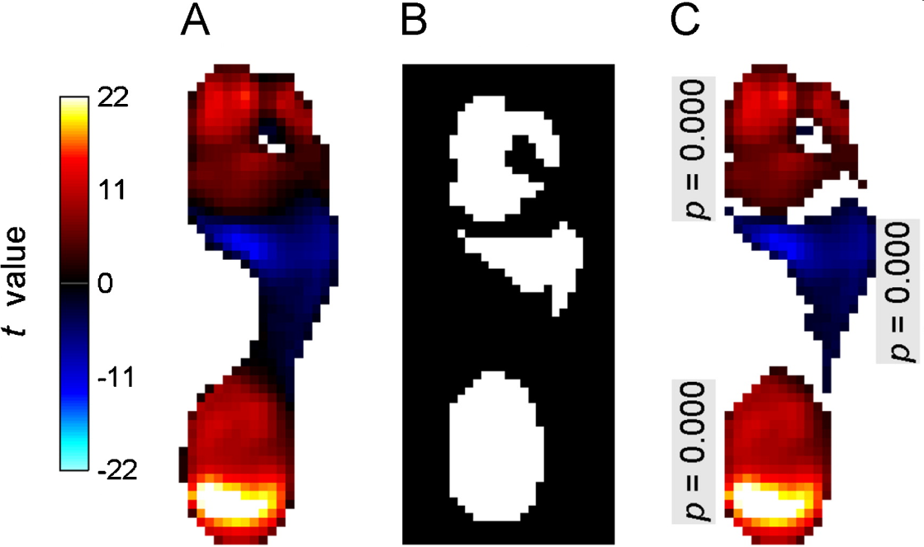
Statistical Parametric Mapping refers to the construction and assessment of spatially extended statistical processes used to test hypotheses about functional imaging data.
Pedobarographic statistical parametric mapping (pSPM), T. Pataky, Journal of Foot and Ankle Research, 2008.

Slide 8
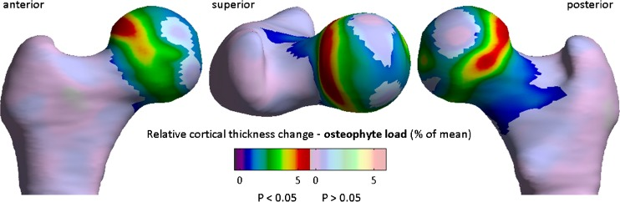
Cortical Bone Mapping (CBM)
Quantitative 3D analysis of bone in hip osteoarthritis using clinical computed tomography, Tom Turmezei et al, European Radiology, 2016.

Slide 9
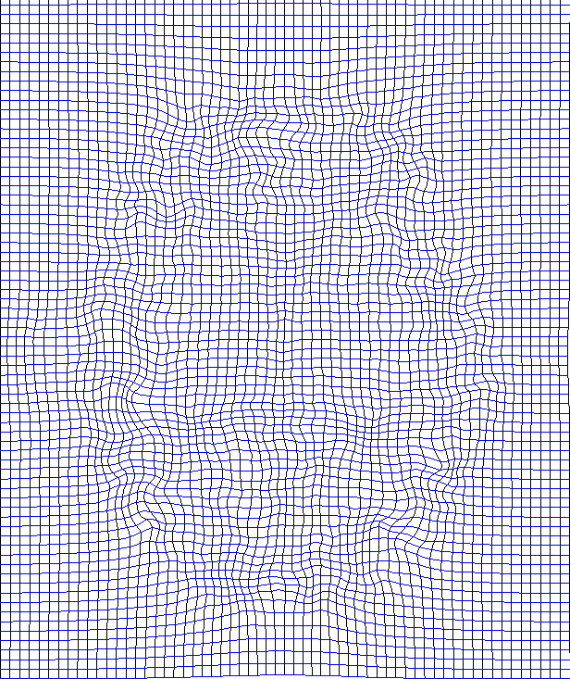
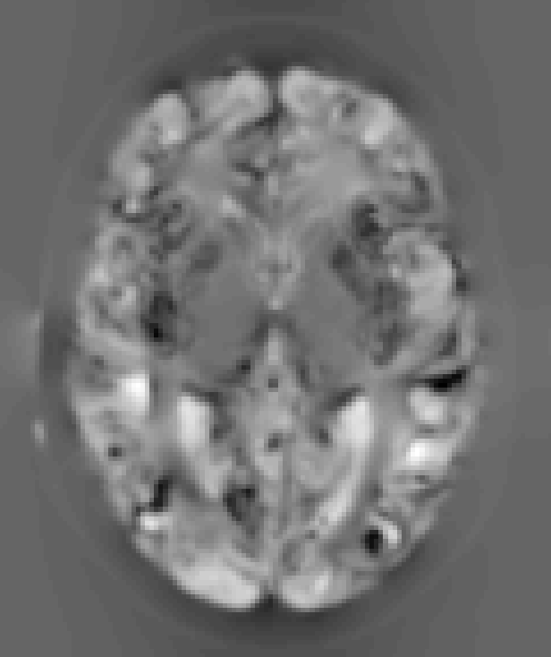
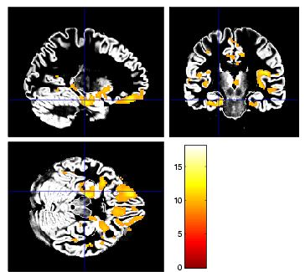
Voxel-Based Morphometry (VBM)
VBM is the most widely used method for computational neuroanatomy.
It is essentially Statistical Parametric Mapping of regional segmented tissue density or volume.
The same general linear modelling & RFT machinery in SPM can then be used to study differences in structure.
Notes:
If we can estimate the transformations that align and warp each subject to match a template, then we can study individual differences in these transformations or derivatives.

Slide 10
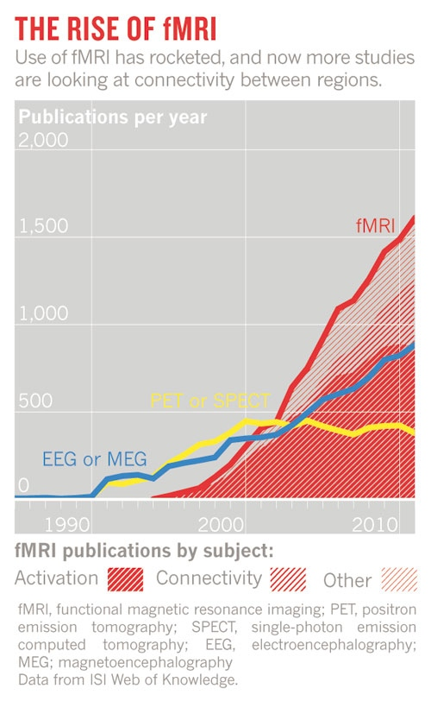
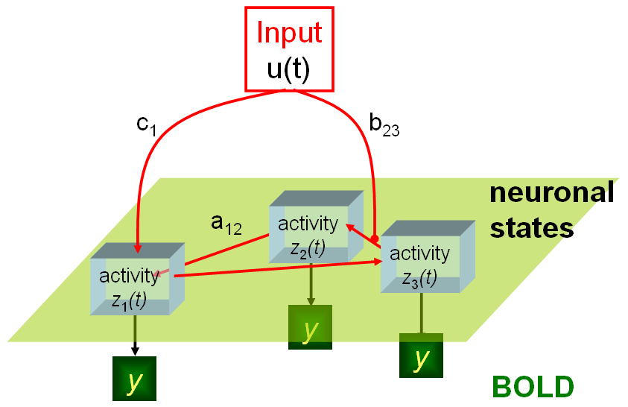
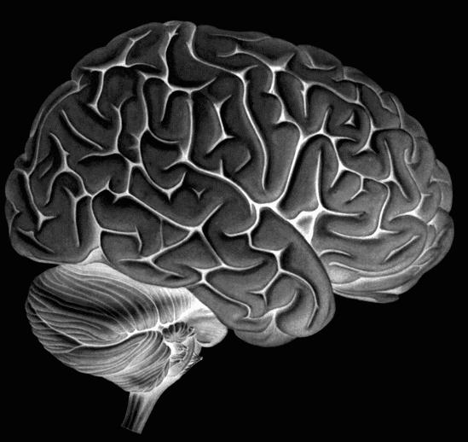
Dynamic Causal Models
Nature, April 2012

Slide 11
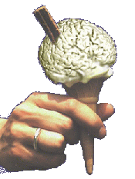
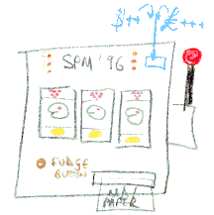
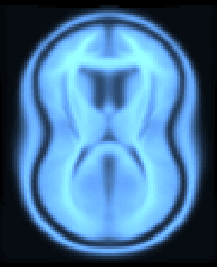
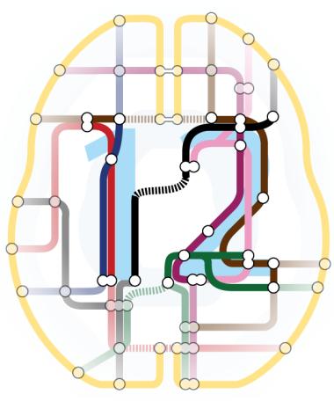
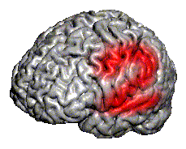
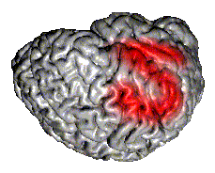
SPM Software
“The SPM software was originally developed by Karl Friston for the routine statistical analysis of functional neuroimaging data from PET while at the Hammersmith Hospital in the UK, and made available to the emerging functional imaging community in 1991 to promote collaboration and a common analysis scheme across laboratories.”
SPMclassic, SPM’94, SPM’96, SPM’99, SPM2, SPM5, SPM8 and SPM12 represent the ongoing theoretical advances and technical improvements of the original version.

Slide 12


Software: SPM12
Free and Open Source Software (GPL)
Requirements:
MATLAB: 7.4 (R2007a) to 9.10 (R2021a) no MathWorks toolboxes required
Supported platforms: Linux, Windows and Mac
Standalone version available.

Slide 13
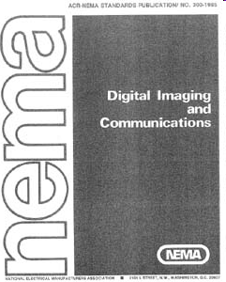
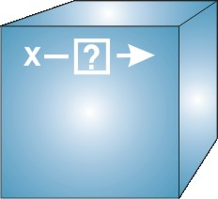
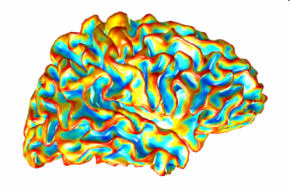
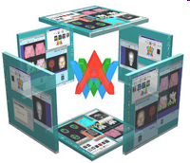
Data File Formats
DICOM: Digital Imaging and Communications in Medicine
NIfTI: Neuroimaging Informatics Technology Initiative
NifTI: volumetric data format (*.nii,*.hdr/*.img)
GIfTI: geometry data format (*.gii)
AnalyzeTM: Mayo Clinic Analyze 7.5 file format (*.hdr/*.img)
Interoperability:
Compatible with AFNI, BrainVoyager, FreeSurfer, FSL, Nipy, …

Slide 14
Brain Imaging Data Structure (BIDS)
“A simple and intuitive way to organise and describe your neuroimaging and behavioural data.”
Benefits of a common standard:
Minimised curation
Within a lab over time
Between labs (collaboration and multi-centre studies)
Between public databases (e.g. OpenfMRI)
Error reduction (automated validation)
Optimised usage of data analysis software (completely automated analysis workflows)

Slide 15
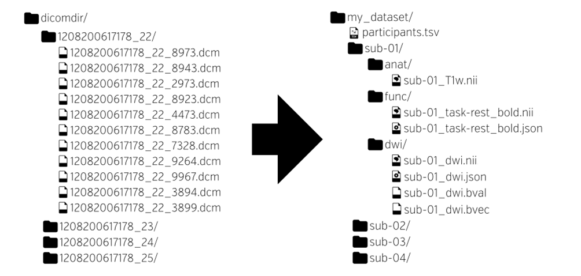
Brain Imaging Data Structure (BIDS)
“A simple and intuitive way to organise and describe your neuroimaging and behavioural data.”
http://bids.neuroimaging.io/
K.J. Gorgolewski et al. The brain imaging data structure, a format for organizing and describing outputs of neuroimaging experiments. Scientific Data (2016)

Slide 16

Brain Imaging Data Structure (BIDS)
participant_id age sex
Sub-001 34 M
Sub-002 22 F
Sub-003 33 F

Slide 17

Brain Imaging Data Structure (BIDS)
NIfTI

Slide 18

Brain Imaging Data Structure (BIDS)
{
“RepetitionTime”: 2,
“EchoTime”: 0.03,
“FlipAngle”: 78,
“SliceTiming”: [0,1.0325,0.06,…],
“PhaseEncodingDirection”: “j-”
}

Slide 19
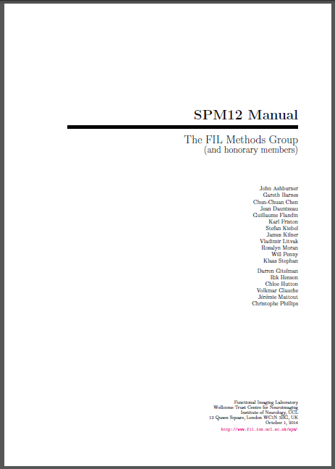
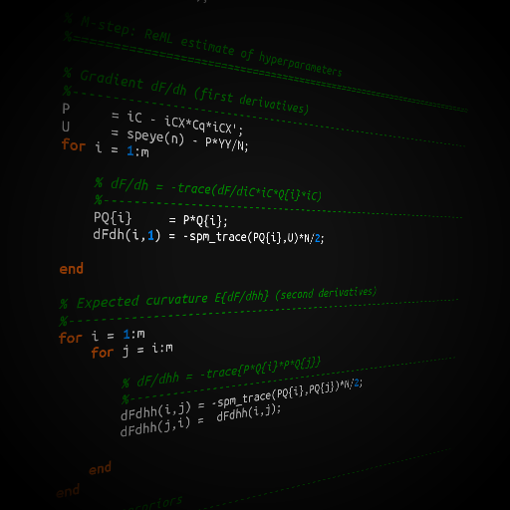
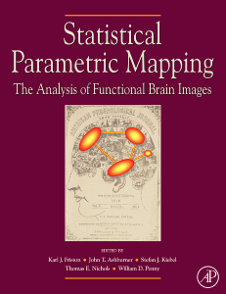
SPM Documentation
Peer reviewed literature
PDF Manual
MATLAB code and comments
SPM Book

Slide 20
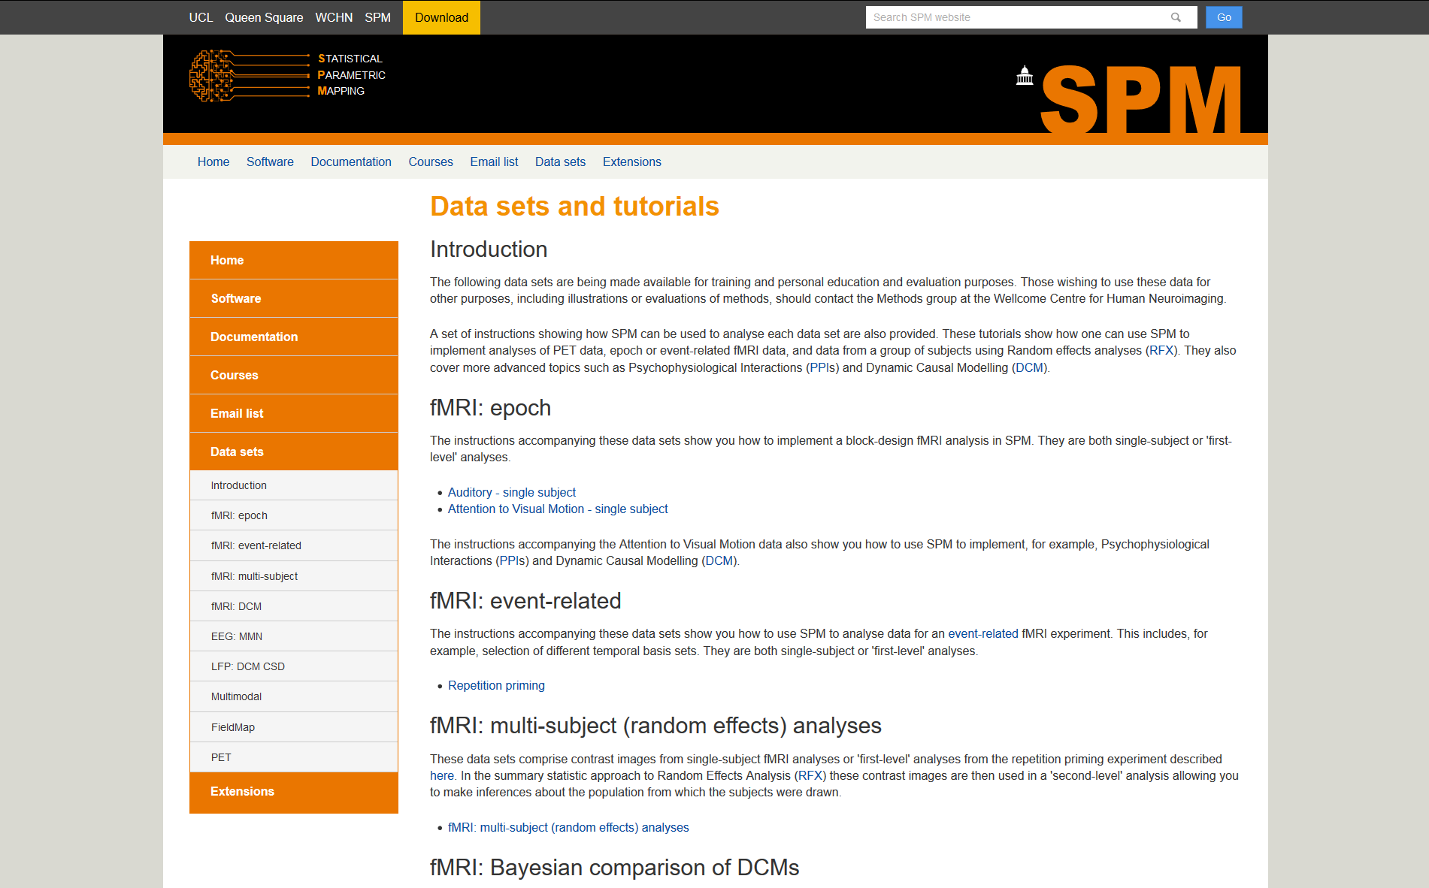
SPM datasets
PET, fMRI (1st and 2nd level), PPI, DCM, EEG, MEG, LFP.

Slide 21
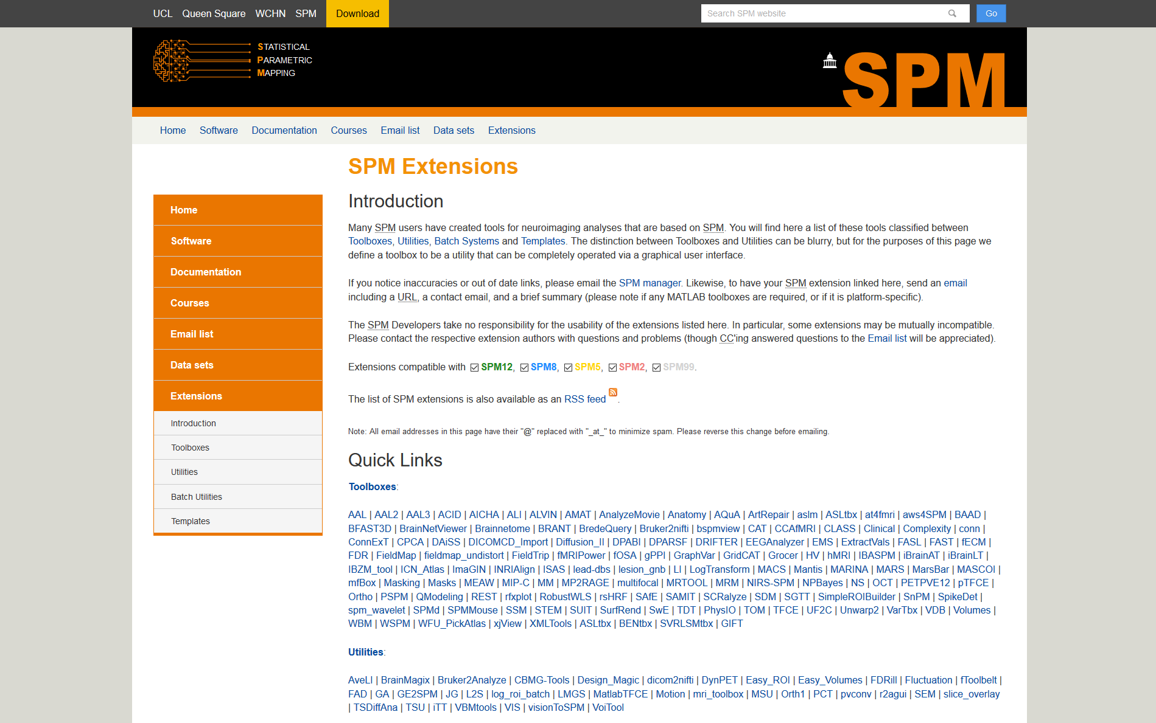
SPM Toolboxes
User-contributed SPM extensions

Slide 22
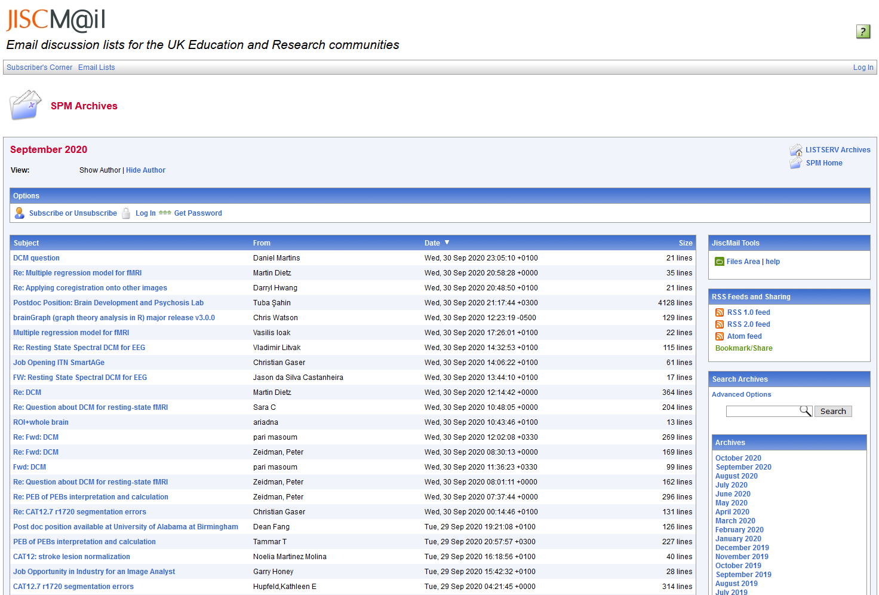
SPM Mailing List
https://www.fil.ion.ucl.ac.uk/spm/support/
spm@jiscmail.ac.uk

Slide 23
The SPM co-authors
Jesper Andersson
John Ashburner
Yael Balbastre
Nelson Trujillo-Barreto
Gareth Barnes
Matthew Brett
Mikael Brudfors
Christian Buchel
CC Chen
Justin Chumbley
Jean Daunizeau
Olivier David
Guillaume Flandin
Karl Friston
Darren Gitelman
Daniel Glaser
Volkmar Glauche
Lee Harrison
Rik Henson
Andrew Holmes
Chloe Hutton
Amirhossein Jafarian
Maria Joao
Stefan Kiebel
James Kilner
Vladimir Litvak
Andre Marreiros
Jérémie Mattout
Rosalyn Moran
Tom Nichols
George O’Neil
Robert Oostenveld
Thomas Parr
Will Penny
Christophe Phillips
Dimitris Pinotsis
Jean-Baptiste Poline
Ged Ridgway
Holly Rossiter
Mohamed Seghier
Klaas Enno Stephan
Sungho Tak
Tim Tierney
Bernadette Van Wijk
Peter Zeidman

